Slide 1

COMP130177.01 互联网体系结构 网络服务质量
赵进
School of
School of Computer Science, Fudan University

Slide 2
1. QoS Definition
2. QoS Metrics
3. IP QoS

Slide 3
网络的模式

Slide 4
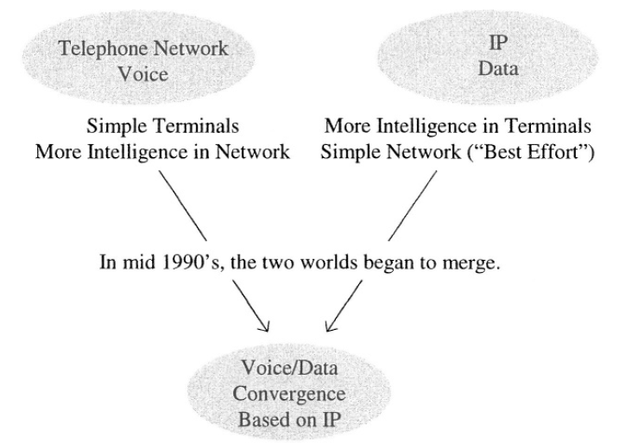
融合

Slide 5
融合带来的挑战
With this convergence, however, a new technical challenge has emerged.
the best effort operation of the earlier IP network is no longer good enough to meet diverse performance requirements,

Slide 6
服务质量 Quality of Service

Slide 7
The Network Evolution
Networks were designed to carry voice traffic
Data traffic mostly overlaid on voice networks (using Modems)
Yesterday…
…Tomorrow ...
Networks are designed to carry primarily data traffic
Voice traffic overlaid on data networks (e.g. VoIP, IPTV)
…Today...

Slide 8
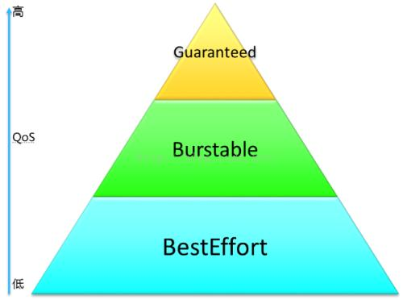
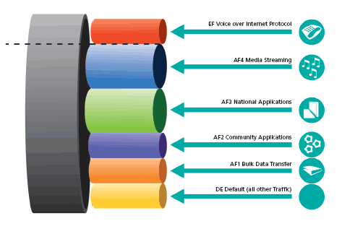
服务质量(QoS)控制概述
广义的网络服务质量
网络性能
可用性
可靠性
安全性
狭义服务质量控制都是为了提高网络保证性能 的能力，和性能相关的主要的QoS参数
带宽
延迟/延迟抖动
分组丢失率

Slide 9
QoS
QoS is defined from two points of view:
QoS experienced by the end user
the end user’s perception of the quality that he receives from the network provider for the particular service or application that he subscribes to, e.g., voice, video, and data.
QoS from the point of view of the network.
the network’s capabilities to provide the QoS perceived by the end user as defined above.

Slide 11
1. QoS Definition
2. QoS Metrics
3. IP QoS

Slide 12
QoS Metrics
Subjective
MOS (Mean Option Score)
Objective
Loss
Delay
Jitter
Throughput
…

Slide 13
MOS
the subjects are asked to rate it on a five-point rating scale of “excellent‚” “good‚” fair‚” “poor‚” and “unsatisfactory.”
N is the total number of subjects

Slide 14
Example
The results of a subjective testing performed with 100 subjects are as follows:
Excellent 30
Good 20
Fair 10
Poor 20
Unsatisfactory 20
Determine the MOS

Slide 16
Origin of MOS Impairments
In a digital communication system
Each layer of the communications
protocol stack introduces impairments.
Quantization noise
Bit error ratio
Delay
Delay variation or “jitter”
Packet loss
The choice of codec
Echo control
The design of the network
Blocking probability

Slide 17
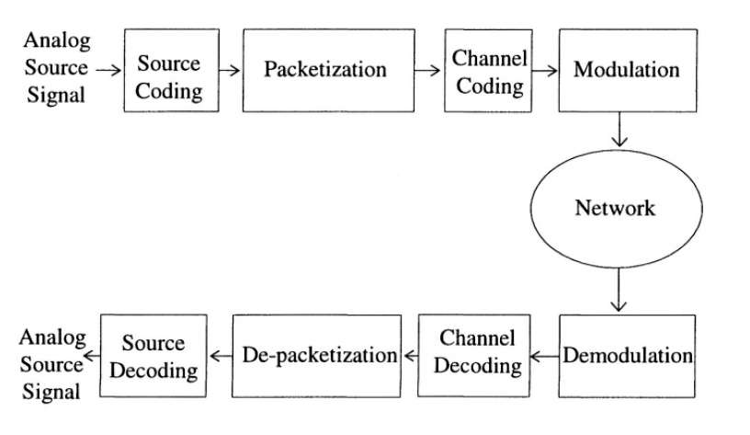

Slide 18
Source Coding

Slide 19
Quantization Noise
Quantization is a process of translating a sampled amplitude to one of a finite number of pre-determined quantized amplitudes that is closest to the actual sampled value.
Quantization error is the difference between the actual sampled amplitude and the quantized amplitude.
The noise due to quantization error
should not be confused with sampling noise

Slide 20
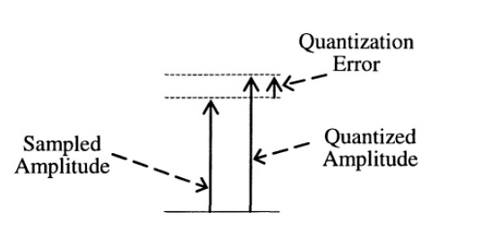
Quantization Error.

Slide 21
Delay
Delay is the time delay incurred in the source signal.
the amount of time measured from the moment the speaker utters a sound until the listener hears the sound.

Slide 22
Major Sources of Delay
Source coding
Delay due to A/D and D/A
Frame delay
Packetization delay
Channel coding
Error detection and correction
Interleaving
Jitter buffer delay
Packet queuing delay
Propagation delay‚ or “speed of light” delay
codec
Network

Slide 23
Jitter buffer delay
Jitter or delay variation affects real time services such as voice and video.
Source of jitter: explained latter
To reduce jitter‚ incoming packets at the receiving end are buffered in a jitter buffer and “played” out at a constant rate.
Typical 60ms

Slide 24
Network Delay
Packet queuing delay
Propagation delay

Slide 25
Packet Queuing Delay
Queuing delay depends on the packet
scheduling algorithm‚ the buffer size‚ and other factors.

Slide 26
Propagation delay
Propagation delay is the time expended for the signal to travel the transmission distance as follows:
D=L/C
L: distance C: speed of light/electron

Slide 27
End-to-end delay objectives
ITU-T G.114 recommends
0 – 150 ms: acceptable for most user applications.
150 – 400 ms: acceptable for international connections.
400 ms: unacceptable

Slide 28
Source of Jitter
All of the delay sources listed above have a fixed value except the packet queuing delay.
As packets go through the packet networks‚ they are queued at routers
Delay varies as traffic pattern changes

Slide 29
Packet loss probability
Bit errors due to transmission line impairments‚ e.g.‚ “fading‚” circuit noise
Link layer packet collisions
Network layer processing errors
Network layer buffer overflows
Network layer random packet discarding

Slide 30
1. QoS Definition
2. QoS Metrics
3. IP QoS

Slide 31
Best Effort
Without a QoS mechanism, an IP network provides the “best effort” service.
all packets are indistinguishable and are given the same forwarding treatment.

Slide 32
IP QoS
A QoS mechanism in the IP network provides a means of distinguishing the packets and treating them differently.

Slide 33
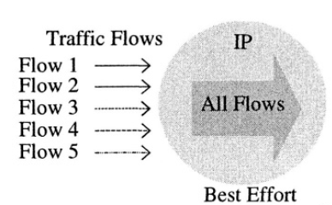
Best-effort
In the best effort service, all packets are lumped into a single mass regardless of the source of the traffic.

Slide 34
Basic Tasks for IP QoS
The network must perform
Task 1 - differentiate between traffic or service types so that users can treat one or more classes of traffic differently than other types
Task 2 - treat the different classes of traffic differently by providing resource assurance and service differentiation in a network

Slide 35
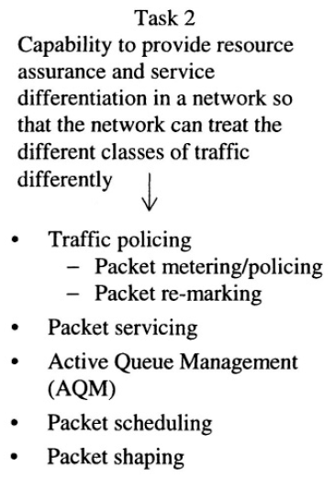
Task 1 is typically performed at user network and network-network interfaces;
Task 2, by the network. Task 2 is implementation-dependent. The network capability to perform Task 2 is a key technology differentiator of manufacturers’ product.

Slide 36
An incoming packet first goes through the packet marking and packet classification modules.
The packet then goes through the packet conditioning and packet servicing modules.

Slide 38
PACKET MARKING
refers to setting the binary bits of appropriate fields in the IP header to specific values for the purpose of distinguishing one type of IP packet from another.
E.g. a packet may be distinguished by its source address, its destination address or a combination of both.
setting the DiffServ Code Point (DSCP) of the DiffServ field of a packet to a specific value.

Slide 39
PACKET CLASSIFICATION
To group packets according to a classification rule.
Different from packet marking
E.g. 10 traffic can be marked by number 1-10
The 10 traffic can be classified into 2 groups
1-5
5-10

Slide 40
Packet Classification Methods
Multi-Field (MF) classification
packets are classified based on a combination of the values of one or more header fields. In addition to the header field, other parameters, e.g., incoming interface identification, may be used for classification purposes as well.
Behavior Aggregate (BA) classification
packets are classified based on the DiffServ Code Point (DSCP) values only.

Slide 41
Multi-Field packet classification

Slide 42
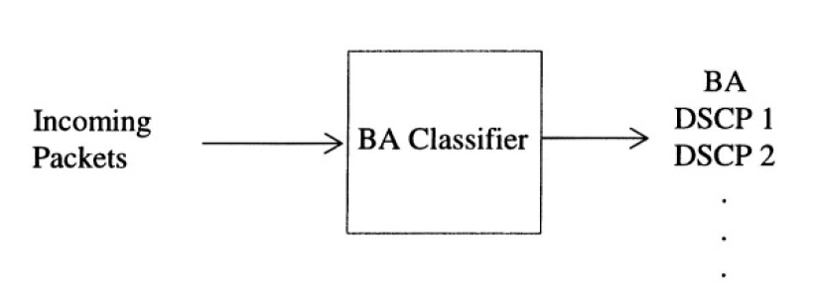
Behavior Aggregate classification

Slide 43
Task 2
TRAFFIC POLICING
ACTIVE QUEUE MANAGEMENT
Packet Scheduling
Traffic Shaping

Slide 44
TRAFFIC POLICING
To check whether the incoming traffic at an input port conforms to the traffic rates that have been agreed upon between the customer and the IP network service provider.
Traffic policing consists of metering the traffic according to preset traffic rates and marking or remarking the packets based on the outcome of the metering.

Slide 46
AQM
In the absence of an Active Queue Management mechanism in a router, the default mechanism is the tail drop method.

Slide 47
Problem of DropTail
DropTail is a passive queue management technique, whereby overflowing packets are discarded automatically only when the queue is completely full.
The main advantage of the tail drop method is its simplicity.
However, the tail drop method causes the phenomenon referred to as the TCP global synchronization.

Slide 48
TCP global synchronization
With the tail drop method, when the buffer is full, all packets arriving at the buffer are dropped indiscriminately.
If these packets are TCP packets, all the TCP sessions associated with the dropped packets would slow down simultaneously and come back with transmission at about the same time.

Slide 49
Since the affected TCP sessions react in a synchronized manner, the congested situation tends to go into oscillation between peaked congestion and off-congestion.
causes inefficient utilization of the network resources,
e.g., the output port bandwidth, buffer space.

Slide 50
AQM
Active Queue Management (AQM) is a congestion control mechanism and its main objective is to prevent the TCP synchronization.
Random Early Discarding (RED)
Weighted Random Early Discarding (WRED)
Explicit Congestion Notification (ECN)
RED and WRED: at queue
ECN: involves end host

Slide 51
Random Early Discarding (RED)
The RED detects an onset of congestion and randomly drops packets from the buffer.
RED employs a congestion prediction algorithm and a packet drop profile as the central components.

Slide 52
Congestion prediction module
assess how the traffic in the buffer behaves over time and detect any buildup of congestion.
The simplest approach would be to look at the instantaneous queue length, N, and determine the state of congestion based on how full the queue is as compared to the buffer size, B,

Slide 53
Packet drop profile
Given the calculated measure of congestion buildup expressed in percent buffer fill,
a packet drop probability is determined based on the “packet drop profile.”
E.g.
Packets are not dropped as long as buffer fill stays below a pre-assigned minimum value
RED is activated when buffer fill exceeds a threshold

Slide 55
The packet drop profile is pre-configured by specifying three factors:
Minimal RED: αmin
Maximal RED: α max
drop probability function: P=f(a)
The degree of aggressiveness of packet dropping can be controlled by these three factors.
E.g. The lower αmin the is set, the more aggressive the RED is
the steeper the slope of f(a), the more aggressive.

Slide 56
RED Effects on UDP
By randomly dropping packets ahead of congestion, the RED prevents the TCP global synchronization.
Since the UDP packets are oblivious to packet dropping, the RED has no effect on UDP traffic flows.
In fact, if the traffic consists of UDP only or at least a majority of UDP, the RED should not be used because packet dropping would have no effect on UDP traffic and would waste packets unnecessarily.

Slide 57
Practical Consideration
Use of the RED requires care in configuring the RED factors and normally requires accumulated experience with regard to the traffic behavior of the network for which the RED is being considered.
a wrong RED algorithm for and a wrong drop profile configuration that is too aggressive in packet dropping would lead to excessive dropping of packets, unnecessarily wasting network resources.

Slide 58
Weighted Random Early Discarding (WRED)
The Weighted Random Early Discarding (WRED) is the RED with multiple drop profiles.
three different drop profiles may be used for the three different colors of packets: the most aggressive profile for A packets, the least aggressive drop profile for B packets, etc.

Slide 59
ECN (RFC 2481)
Explicit Congestion Notification (ECN) method is a congestion control method applied to the TCP traffic.
an experimental addition to the IP architecture.

Slide 60
In the ECN, an onset of congestion is communicated to the end systems by marking the appropriate fields in the TCP and IP headers with congestion indication rather than dropping packets.
Hence, the main difference between the RED and the ECN is that, in the
RED, packets are randomly dropped,
ECN, the randomly selected packets are allowed to pass (i.e., not dropped) with the congestion indication mark to notify the end systems.

Slide 61
IP and TCP header
The ECN requires making both the IP and the TCP headers.
The last two reserved bits in the eight-bit Type of Service (TOS) field in the IPv4 header and
the eight-bit Traffic Class field of the IPv6 header are used for marking ECN in IP packets.

Slide 62
TCP
The ECN also requires defining two flags using the two bits of the reserved field in the TCP header. These two flags are specified in RFC 2481
the ECN-Echo flag and the Congestion Window Reduced (CWR) flag.

Slide 63
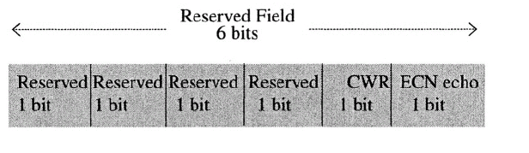
TCP

Slide 64
ECT bit
ECN-Capable Transport (ECT)
The ECT bit is set by the source TCP application indicating to the routers in the IP network that the packets are eligible for the ECN.
When a router anticipates congestion, it sets the CE bit to ‘1’ in the packets with the ECT bit equal to ‘1’ to indicate congestion to the end systems.

Slide 65
The source and destination TCP hosts use the Echo flag and the CWR flag of the reserved field and the SYN and ACK bits of the code field for “handshaking” for the ECN.
ECN echo: dest to source, announcing CE received
CWR: source to dest, Announcing CW reduced

Slide 66
ECN operations
packet leaves the source host with the ECT bit set to ‘1’ and the CE bit set to 0. The CE bit is flipped to ‘1’ at the router that detects an onset of congestion
The receiving TCP host flips the echo bit to ‘1’ in the TCP ACK packet to tell the source host that there is congestion in the network.

Slide 67
CE=1

Slide 68
PACKET SCHEDULING
Packet scheduling is to “schedule” the packets in the queues in such a way that the fixed amount of an output port bandwidth is “equitably” and “optimally” distributed among the competing classes of incoming traffic flows that are routed to that output port.

Slide 69
Major types of packet scheduling
First-in-first-out (FIFO)
Priority queuing (PQ)
Fair-queuing (FQ)
Weighted Round Robin (WRR)
Weighted Fair Queuing (WFQ)
Class-Based WFQ

Slide 70
FIFO
First-in first-out (FIFO) is a default queuing mechanism in the absence of any specific packet scheduling algorithm.
packets are queued in a single queue in the order they arrive and are sent out on the outgoing link in the same order they are queued.

Slide 71
FIFO Queue
FIFO queue is also referred to as the first-come-first-served (FCFS) queue.

Slide 72
Advantages
Simplicity！
No special algorithm is required to implement the FIFO.
a single buffer
FIFO treats all packets equally and, therefore, is best suited for the best effort network.

Slide 73
Drawbacks
FIFO does not distinguish (or has a very limited capability to distinguish) traffic classes.
All traffic flows suffer equally during congestion.
FIFO tends to favor UDP traffic over TCP traffic during congestion because the TCP protocol backs off during congestion.

Slide 74
Priority Queuing (PQ)
FIFO
puts all packets in a single queue without regard to traffic class distinction.
PQ:
creating class distinction

Slide 75
PQ
In the PQ, N queues are created with the priority ranking 1 through N.
The scheduling order is determined by the priority order and by whether there are packets in higher priority queues.
The packets in the queue are processed only if there are no packets in any of the higher priority queues, i.e., Queues 1 through (j-1).

Slide 76
Example
there is no preset order in PQ
if a packet arrives at any of the queues above Queue j, say Queue (j-3), while the scheduler is at Queue j, the scheduler goes to Queue (j-3),

Slide 77
Advantage : simplicity
A simple means of creating traffic class distinction
Drawback
cause the phenomenon referred to as “starvation” of low priority queues.
if the higher priority queues always have packets to be processed, the lower priority queues may never get a chance to send packets out

Slide 78
Application
PQ is particularly suitable if the high priority traffic makes up a small fraction of the overall traffic of all the queues.
E.g. suppose that a tiny fraction of the overall mass of traffic is extremely critical and must always be processed and sent out as quickly as possible.
Since the priority traffic is small, its effect on the rest of the traffic would be minimal and there is no danger of creating starvation.

Slide 79
The PQ is a convenient and simple means of creating queues dedicated to real time traffic,

Slide 80
Rate-Controlled PQ
To prevent the starvation problem and ensure a minimum amount of bandwidth for the lower priority queues
the packets in a high-priority queue are scheduled before the packets in the lower priority queues only if the amount of traffic in the high-priority queue stays below a re-specified threshold level.

Slide 81
Example
Suppose that the Priority 1 queue is rate limited to 10% of the output port bandwidth.
the scheduler operates in the PQ mode as long as the bandwidth consumption by Priority 1 queue stays below 10% of the output port bandwidth.

Slide 82
Fair Queuing (FQ)
FQ:
Another more general means of creating traffic class distinction
also referred to as per-flow or flow-based queuing.

Slide 83
FQ
In the FQ, incoming packets are classified into N queues. Each queue is allocated 1/N of the output port bandwidth.
The scheduler visits the queues according to the round robin order skipping empty queues.
At each scheduled visit of a queue, one packet is transmitted out of the queue.

Slide 84
Advantage
FQ is simple. It does not require a special bandwidth allocation mechanism.
If a new queue is added to the existing N queues to create a new traffic class, the scheduler automatically adjusts the individual queue bandwidth to 1/(N+1) of the output port bandwidth.

Slide 85
Drawbacks
First, since the output port bandwidth is divided to the N queues equally by 1/N, if the input traffic classes have different bandwidth requirements, the FQ will not be able to distribute the output port bandwidth among the input flow classes according to their bandwidth requirements.

Slide 86
Second, since one whole packet is transmitted per each scheduled visit of a queue regardless of the packet size, the packet size will impact the actual bandwidth distribution among the queues even though each queue is visited equally by 1/N.

Slide 88
Example
Consider a FQ with four queues with Flows 1, 2, 3, and 4
Assuming that the average packet sizes of the four flows are 200, 100, 400 and 300 bytes, respectively,
determine the percentage shares of the output port bandwidth used by the four flows.

Slide 91
Weighted Round Robin (WRR)
WRR queuing addresses the first drawback of FQ (i.e. purely equal BW)
WRR divides the output port bandwidth to input traffic classes according to their bandwidth requirements.
WRR is also referred to as the class-based queuing (CBQ) or custom queuing.

Slide 92
First, the input traffic flows are grouped into m classes
the output port bandwidth is distributed to the m classes according to appropriate weights determined by the bandwidth requirements of the m classes.
The weights should add up to 100%:

Slide 94
Intra-Class Scheduling
Within each class, individual flows are scheduled by the FQ.
Denoting the number of FQ’s in Class i by Ni, the total number of FQ’s in the WRR scheduling is given by the following: (i.e. sum of all classes)

Slide 95
2-Layer RR
WRR involves two layers of round robin scheduling.
First, Classes 1 through m are visited by the scheduler in the round robin order. Refer to this as the first layer round robin.
When the scheduler is with a particular class, the FQ’s within that class are visited by the scheduler in the round robin order. Refer to this as the second layer round robin.

Slide 96
Bandwidth Sharing
The percentage of the output port bandwidth given to Class i, i.e., weight for Class i, Wi, can be realized by specifying the amount of time spent by the scheduler with Class I
E.g. suppose that Class i is given 20% of the output port bandwidth, The scheduler must spend 20% of the time during the first layer round robin cycle with Class i.
While the scheduler is with Class i, it spends an equal amount of time with each of the FQ’s,

Slide 97
WRR Example
Consider a WRR with two classes, Class 1 and Class 2. The total output port bandwidth is 200 Mb/s
40% and 60% of the output port bandwidth are allocated to Class 1 and Class 2, respectively.
Class 1 has two flows and Class 2 has eight flows.
Assume that all flows have the same packet size.
Determine the output port bandwidth consumed by each of the eight flows.

Slide 98
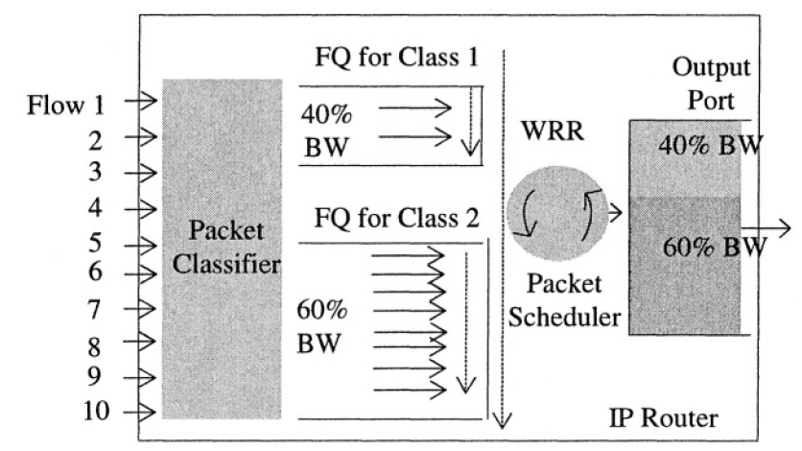
Class 1 80 mb/s.
Each of the two flows has 40 mb/s.
Class 2 120 mb/s.
Each of the eight flows has 15 mb/s.

Slide 99
Weighted Fair Queuing (WFQ)
WRR addresses the first drawback of the FQ,
WRR does not address the second drawback of the FQ, i.e., the packet size impact on bandwidth share
Weighted Fair Queuing (WFQ) addresses this drawback

Slide 100
WFQ
In the WFQ, as in the FQ, the input traffic flows are grouped into m queues;
however, the output port bandwidth is distributed to the m queues according to appropriate weights determined by the bandwidth requirements of the m classes rather than equally divided, where the weights add up to 100%:

Slide 101
Difference
In the FQ, each queue sends out one whole packet during a scheduled visit.
In the WFQ, the scheduler sends out the packets from the queues based on the calculated order of the packet finish time.
WFQ attempts to approximate a theoretical model referred to as the weighted bit-by-bit round robin scheduler (not practical)

Slide 102
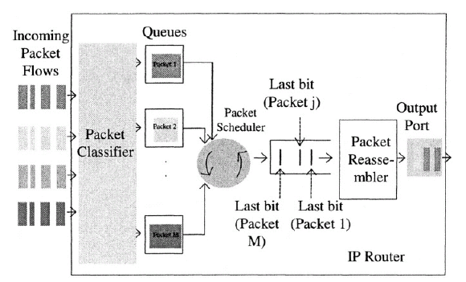
Theoretical Model

Slide 103
Bit-by-bit Round-robin
at each scheduled visit, the scheduler takes out one bit from the queue at a time;
the packet assembler collects all the bits of a packet,
when the packet is reassembled, it is sent out.
Hence, a larger size packet must wait longer to be reassembled.
This bit-by-bit scheduler is a theoretical model only and is not practical.

Slide 104
GPS
The idealized Fluid Model is also referred to as Generalized Processor Sharing(GPS)
GPS effectively computes the ideal finishing time in terms of rounds
packets are said to depart the system when they reach their finishing times => Packets with smallest finishing times are transmitted first.

Slide 105
Packet-oriented GPS == WFQ
The WFQ only services whole IP packets (it doesn’t split them into bits).
the WFQ will service entire packets in the same order as the perfectly fair service order of a fluid-flow GPS system
i.e., the next packet to be transmitted over a transmission line by the WFQ is the packet with the smallest GPS Virtual Finishing time amongst all waiting packets

Slide 106
Practical Approach
WFQ calculates the finish times of the packets and sends them out from the output port in the order of the finish times calculated by the scheduler.

Slide 107
Adding Weights to GPS or WFQ
In a real IP router, different flows will have different bandwidth requirements
Let each flow i have its own buffer and a ‘weight’ Wi which determines its relative share of bandwidth C (bits/sec)

Slide 108
WFQ Implementation
Finish time for flow i’s j-th packet at time t:
F_{i}(j,t)=max{F_{i}(j-1,t),R(t)}+P_{i}(j,t)/w_{i}
Where
P_{i}(j,t) is the size of the j-th packet
Wi is flow i’s weight
R(t) is the round number (virtual time): number of rounds of service completed by a bit-by-bit RR scheduler at t
Usually only the F for first packet in each queue is of interest at any given time
The scheduler will select the packet with the smallest virtual finish time.

Slide 109
Example
Consider the three queues with WFQ scheduling
Determine the order of transmission of the three packets in the output port.

Slide 110
F_{i}(j,t)=max{F_{i}(j-1,t),R(t)}+P_{i}(j,t)/w_{i}
At t=0
F1(A,0)=0+30/0.1=300
F2(B,0)=0+120/0.2=600
F3(C,0)=0+140/0.7=200, min, selected.
After a packet arrival or departure, F is updated

Slide 111
Quiz
Consider 3 flows being serviced by a link with capacity C = 1 Mbps (ie 1 usec per bit). Assume each flow has its own queue with weights 5, 10, and 20 (bits/round).
Flow 1: pkt with 100 bits arrives at time t = 0 usec, weight = 5 "
Flow 2: pkt with 300 bits arrives at time t = 50 usec, weight = 10 "
Flow 3: pkt with 200 bits arrives at time t = 100 usec, weight = 20
What are the departure times of the last bit in each flow, first expressed in Rounds (Virtual-Time), and then expressed in Real-Time ?

Slide 112
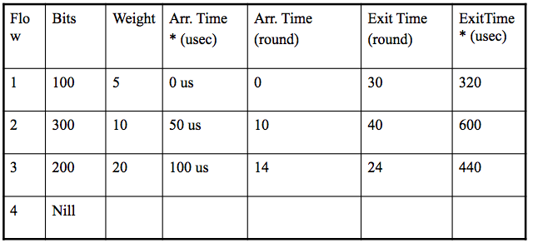
Solution
Assume new flows arrive at the beginning of a round, for simplicity.

Slide 113
Class-Based WFQ (CB WFQ)
CB WFQ is similar to WRR
The input traffic flows are grouped into m classes
the output port bandwidth is distributed to the m classes according to the appropriate weights determined by the bandwidth requirements of the m classes

Slide 114
CB-WFQ vs WFQ
CBWFQ extends the WFQ functionality by providing support for user-defined traffic classes instead of individual flows.
IP doesn’t have any easy way to specify flows. Therefore, classes are defined by a match criteria on packet headers which include:
Protocols (TCP, UDP, RTP, etc)
IP addresses
TCP and UDP ports

Slide 115
WRR vs CB-WFQ
The difference is within each class.
In the CB WFQ, within a class, individual flows are scheduled by the WFQ,
whereas in the WRR, they are scheduled by the FQ.

Slide 116
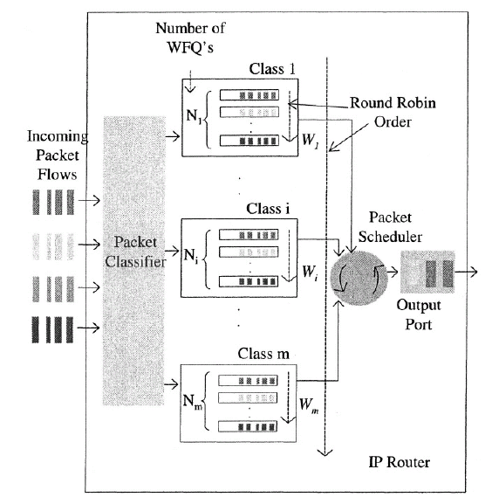

Slide 117
Denote the number of WFQ’s in Class i by then, the total number of WFQ’s in the CB WFQ scheduling is given by the following:
The bandwidth allocated to Class i is further distributed among the Ni queues within Class i according to appropriate weights, The weight given to WFQ j in Class i is given by
Class i’s percentage * j’s percentage in class i

Slide 118
Packet Scheduling Summary
First-in-first-out (FIFO)
Priority queuing (PQ)
Fair queuing (FQ)
Weighted Round Robin (WRR)
Weighted Fair Queuing (WFQ)
Class-Based WFQ

Slide 119
TRAFFIC SHAPING
to change the rate of incoming traffic flow to regulate the rate in such a way that the outgoing traffic flow behaves more smoothly.
If the incoming traffic is highly bursty, it needs to be buffered so that the output of the buffer is less bursty and smoother.

Slide 120
Traffic shaper
Two types
Pure traffic shaper
Token bucket traffic shaper

Slide 121
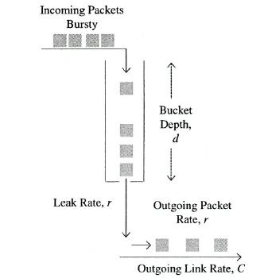
Pure traffic shaper
Incoming packets are put into a buffer, or a “bucket,” with depth d, and are sent out on the outgoing link at a constant rate, referred to as leak rate
Typically, the leak rate, r, is much smaller than the link rate, C.

Slide 122
However, with the pure traffic shaper, the leak rate r places the upper limit on the outgoing rate of the traffic flow, because it does not allow bursts on the outgoing link.
If the burst size exceeds the bucket depth, d, the overflowing packets would be dropped.

Slide 123
Token bucket traffic shaper
Also referred to as the leaky bucket traffic shaper.
token bucket traffic shaper uses a token bucket
Tokens are put into the token bucket at a constant rate referred to as the token rate, r.
The token bucket has a maximum size, which is referred to as the bucket depth, d.
If the token bucket is full, no more tokens are put into the bucket.

Slide 124
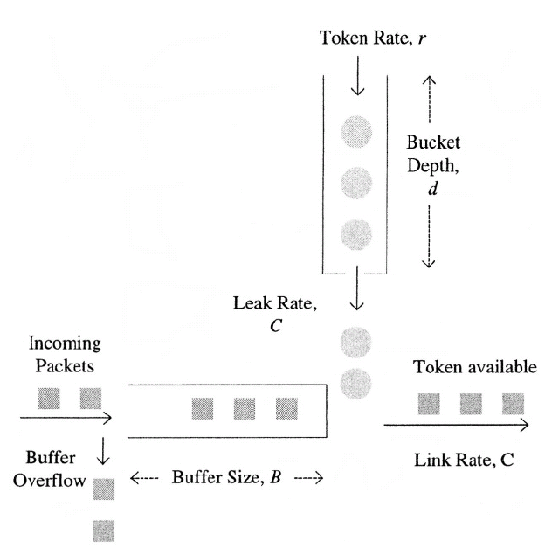

Slide 125
Operation
Each token allows the input traffic buffer to send out one byte of packet.
When there is no packet in the buffer to send out, the “bottom” of the token bucket is closed and no tokens are taken out.
When there are packets in the buffer, the tokens are withdrawn at the outgoing link rate, C, and so the packets are “bursted out” on the outgoing link.
When no more tokens left, packets in the buffer must wait for tokens to be put into the bucket

Slide 126
Burst
Packet bursts are permitted on the outgoing link at the link speed C.
The burst size is limited by the bucket depth, d.
Since tokens are put into the bucket at the token rate r, the long term average rate of the packets on the outgoing link would be r.

